Slide 1
Probabilistic Modeling of Driver Behaviors
At Urban Crossroads
Yuan-Cheng Liu
Advisor : Kuei-Yuan Chan
2019/07/19

Slide 2
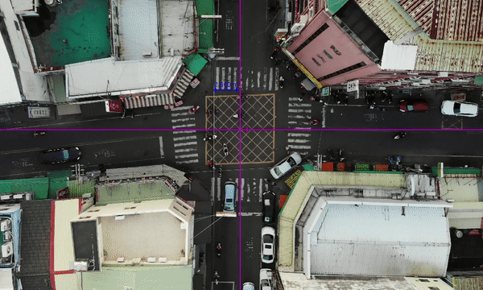
Introduction : How do we cross an intersection ?
How are the decisions made ?
Can the mechanism be formulated ?

Slide 3
Outline
Introduction
Literature Review
Thesis Objectives
Driver Behavior Modeling
  Model Validation
  Summary
Applications
Conclusions
Future Works

Slide 4
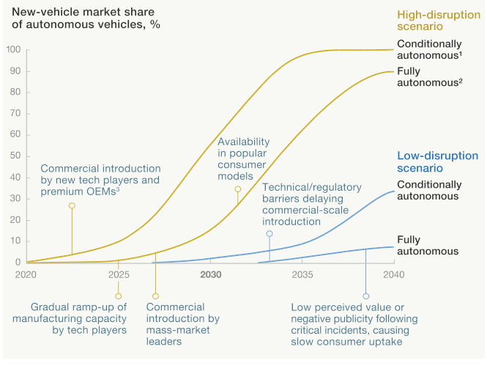
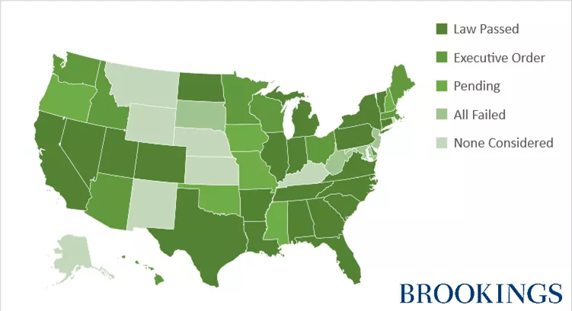
Introduction : Why are crossroads important ?
At least in the next 30 years, interactions with human drivers are unavoidable
for autonomous vehicles ^{[1]}.
Autonomous vehicle industry has been growing rapidly while public road testings are all over the US.
There are intensive interactions among traffic participants at the crossroads, especially those without signals.
Source :brookings.edu
Source : mckinsey.com
[1] Bansal, P. et al. (2017)

Slide 5
Introduction : How do autonomous vehicles overcome unsignaled crossroads ?
Over-cautious maneuvers are not necessarily safe.
Report of Traffic Collision Involving an Autonomous Vehicle
Autonomous vehicles being rear-ended accounts for 18 out of 33 filed reports, which is mainly due to unexpected stops. ^{[2]} (as of June 17, 2019)
Almost all of these rear-ended accidents are due to abrupt brakes that the following vehicle can not understand.
Rear-ended
55%
Other
45%
[2] Department of Motor Vehicles, State of California

Slide 6
Literature Review : How to predict the behaviors of surrounding vehicles?
Some are too simple ( [7] ) to generate long-term prediction while some are too complicated ( [14, 15] ) to be applied real-time.
Driver behavior models are more rational and more practical ; however, models using pre-trained data are site-specific [16, 17].
A more straight forward model without learning steps and applicable to different scenarios is needed.
[7] Ammoun, S. et al. (2009); [14] Foka, A. et al. (2010); [15] Hubmann, C. et al. (2018); [16] Liebner, M. et al. (2012);
[17] Graf, R. et al. (2014)

Slide 7
Thesis Objectives
Driver behavior model based on the cognitive information.
How are the decisions made ?
  How decisions are made by drivers at urban crossroads.
Can the mechanism be formulated ?
  How to use the mechanism to predict the behaviors ?

Slide 8
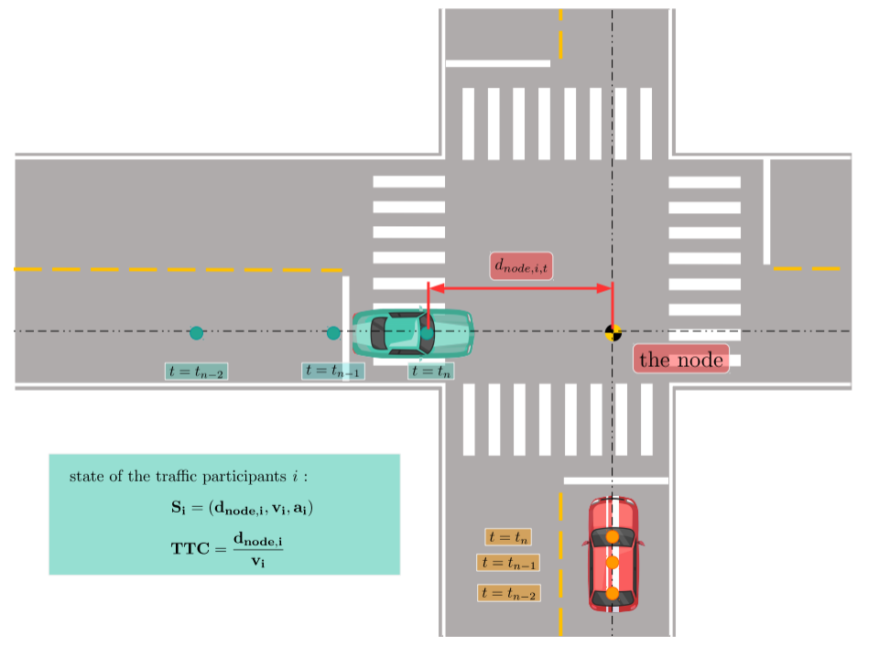
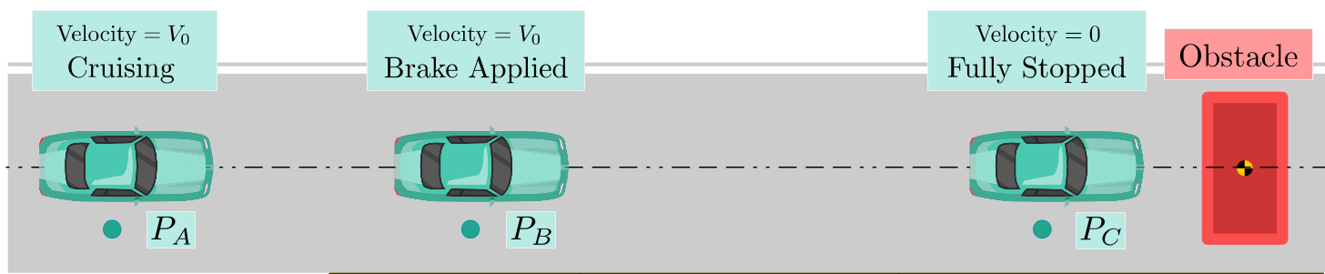
Driver Modeling : How are the decisions made ?
Scenarios:
    2 participants at the scene
    Fixed path for both cars
    Pass / Yield
    Collision is unavoidable if velocities remain the same
    The node

Slide 9
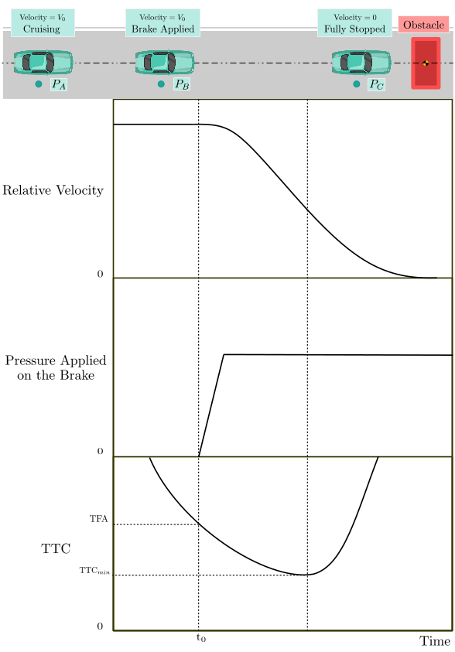
Driver Modeling : How are the decisions made ?
Time to Collision (TTC) ^{[22]}
    It is the tool drivers use to decide the moment of braking.
    Formulation :
Time for Action (TFA)
    TTC threshold for a driver to brake.
    Vary from person to person.
TFA
Threshold to Brake
[22] Cavallo, V. et al. (1988)

Slide 10
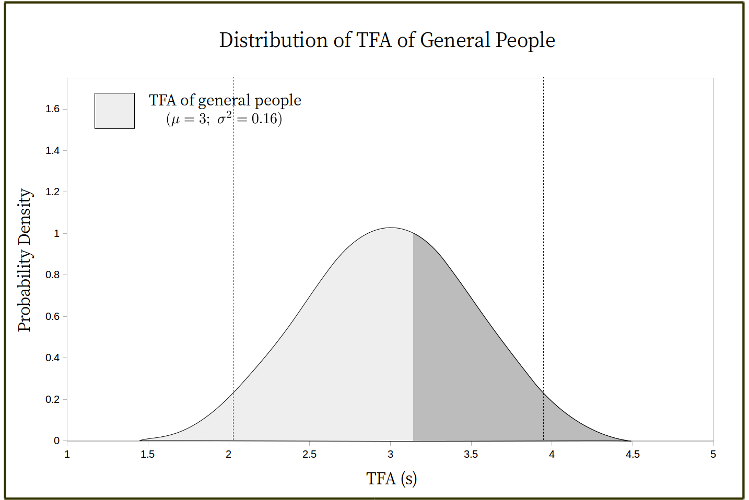
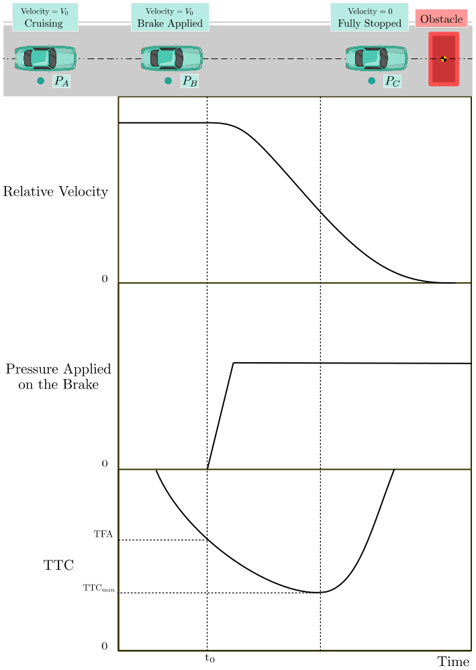
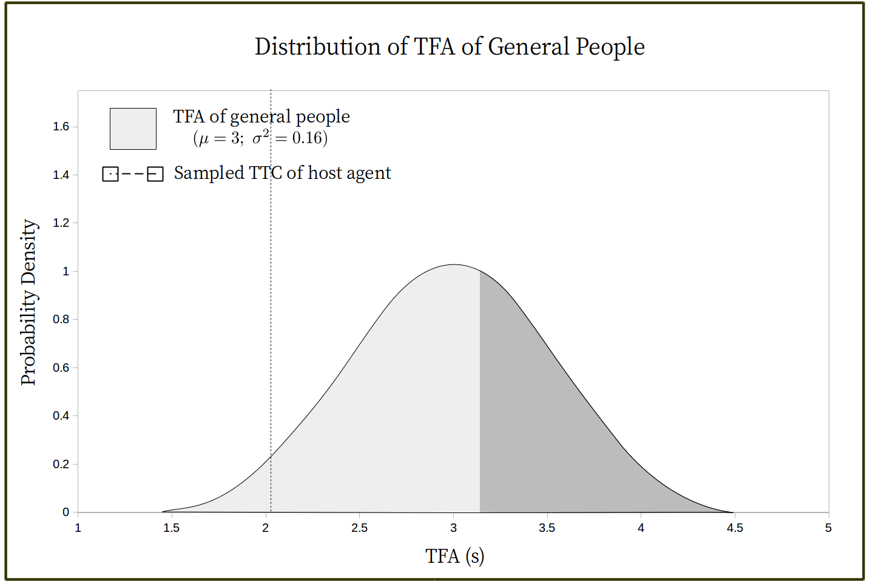
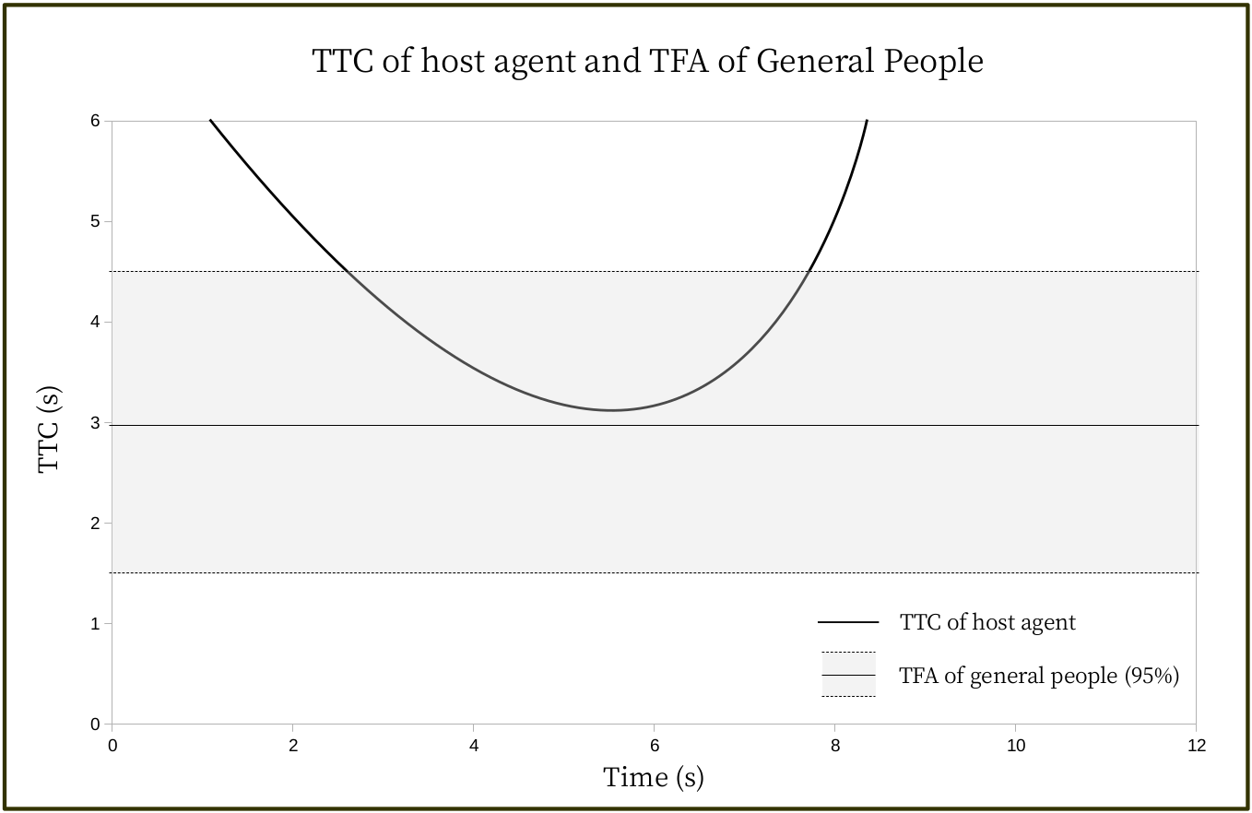
Driver Modeling : How are the decisions made ?
TFA is a distribution.
t₀
t₁
t₂
t₀
t₁
t₂

Slide 11
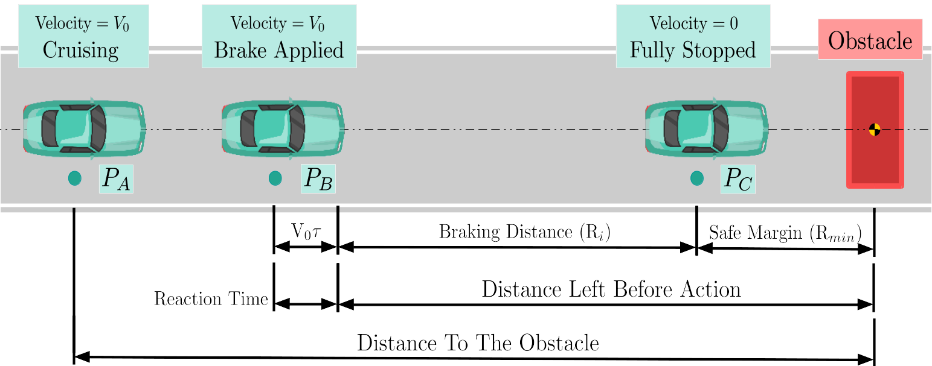
Driver Modeling : Can the mechanism be formulated ?
Estimated TFA :
Reaction Distance
Braking Distance (R_{i})
Safe Margin

Slide 12
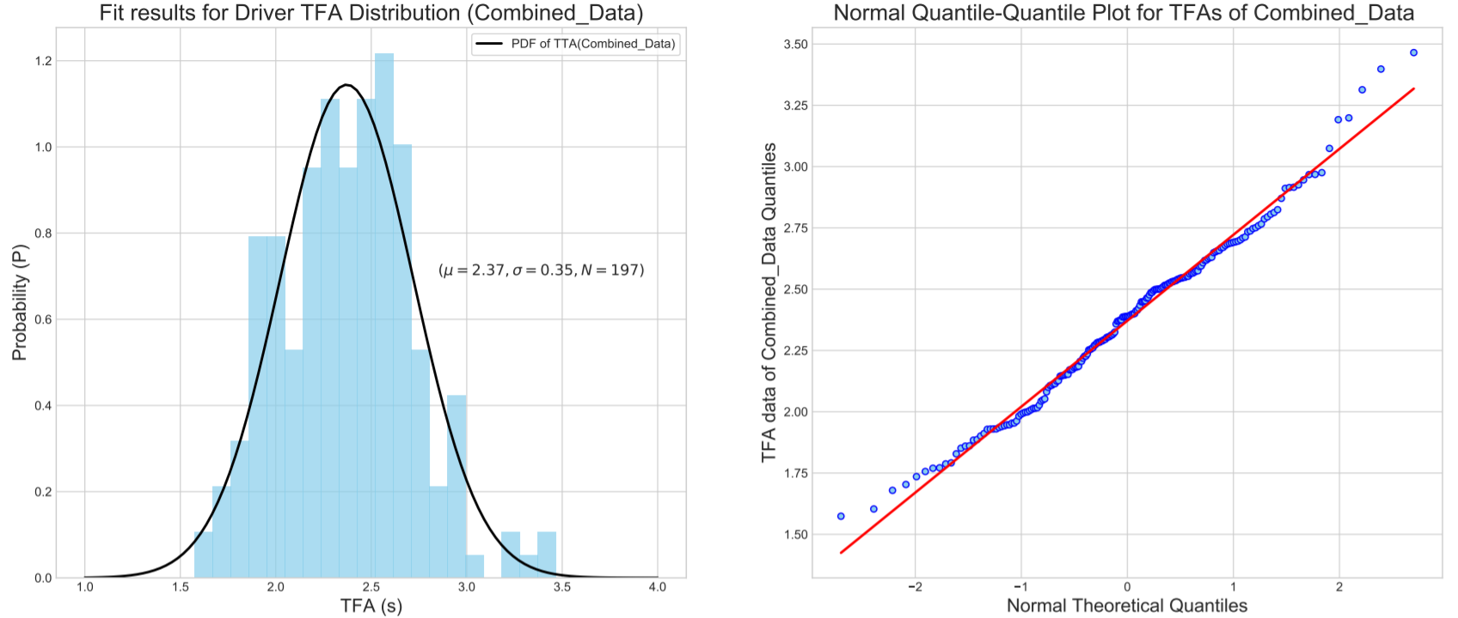
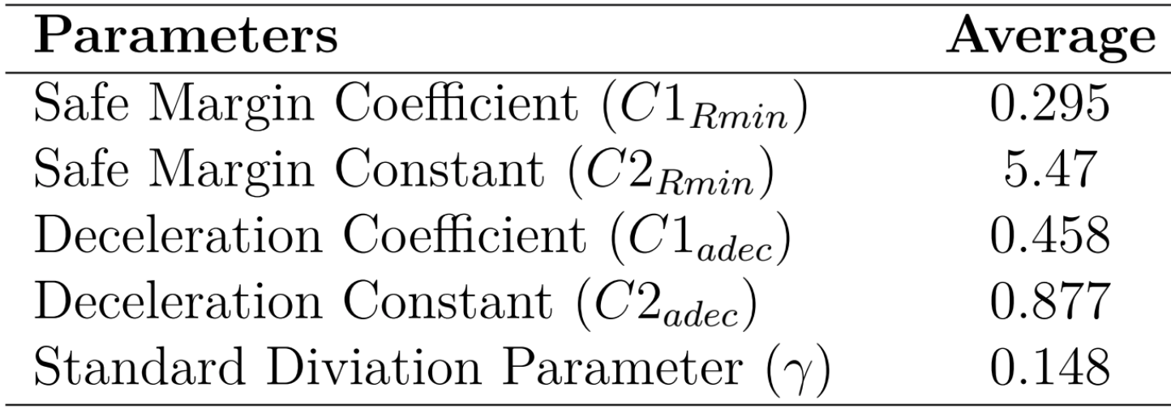
Driver Modeling : Can the mechanism be formulated ?
TFA distribution modeling
mean :
standard deviation :

Slide 13
Driver Modeling : Can the mechanism be formulated ?
Accelerating ?
Current TTC

Slide 14
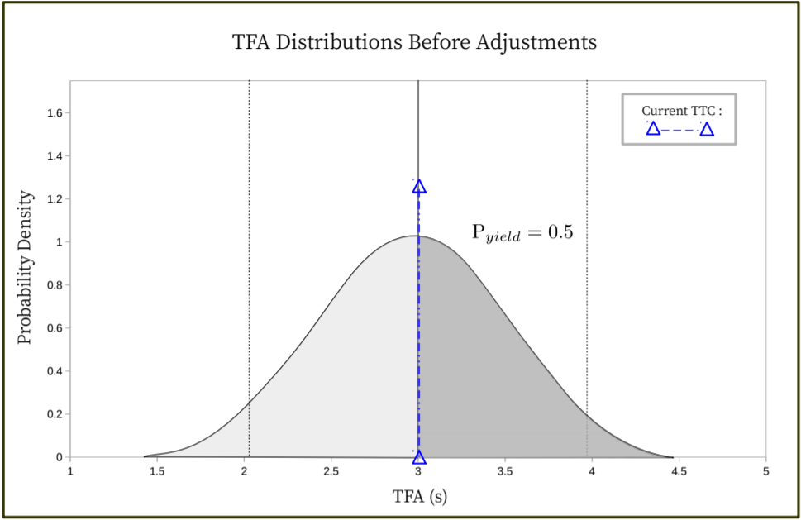
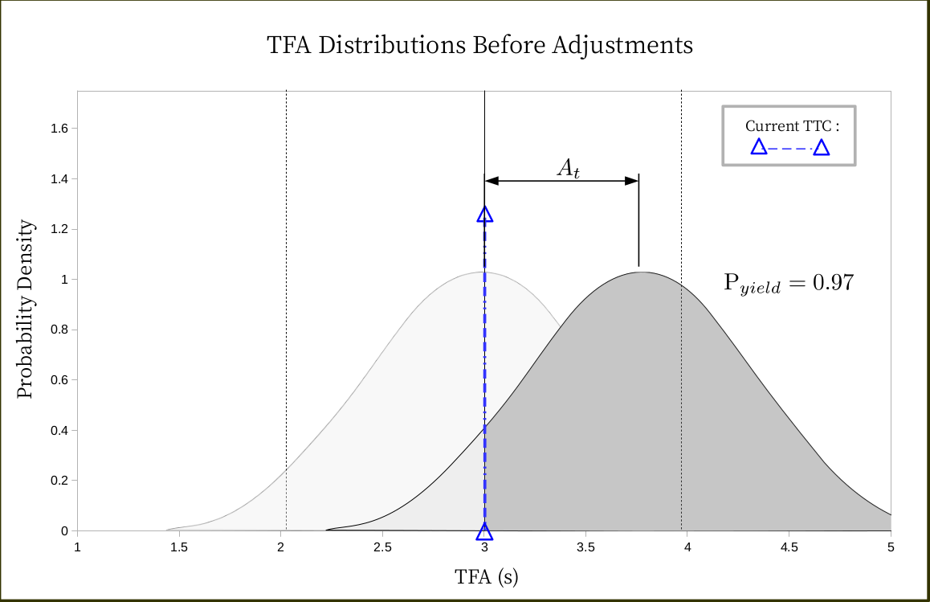
Driver Modeling : Can the mechanism be formulated ?
To account for : 1. Accelerating or at high speed and 2. Decelerating or at low speed, the adjustment term is added.
To emphasize on
the acceleration term
To keep the value
greater than 1
Larger the acceleration
larger the adjustment
ADJUSTMENT

Slide 15
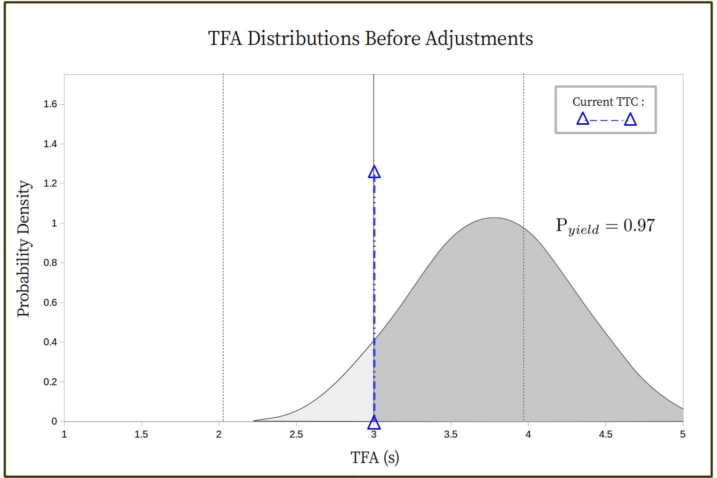
Driver Modeling : Can the mechanism be formulated ?

Slide 16
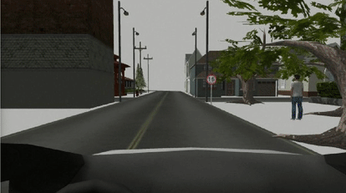
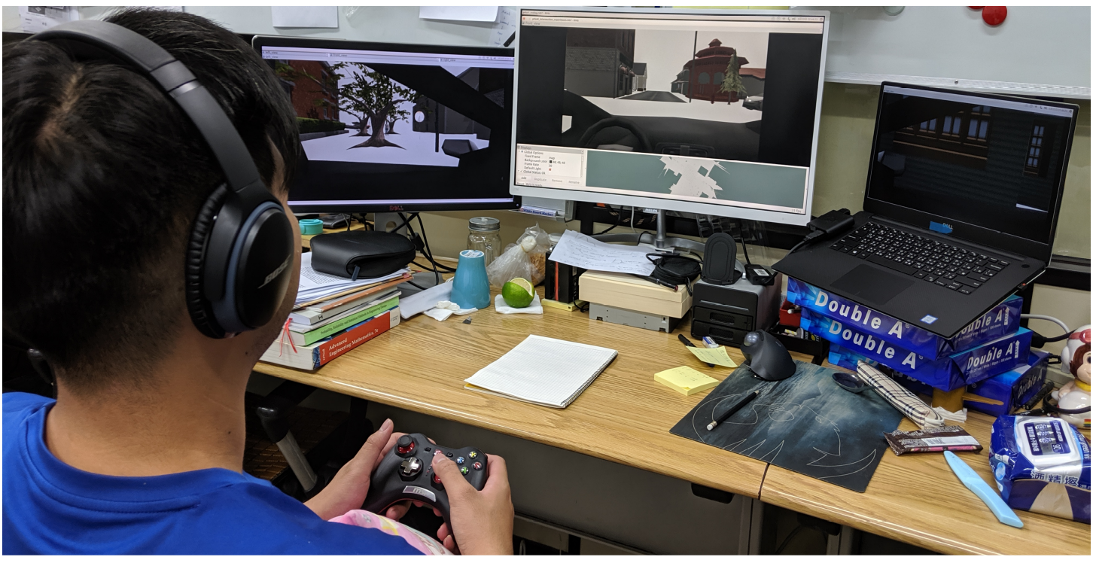
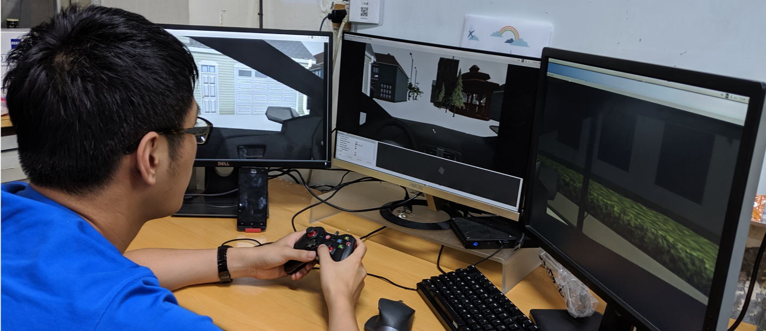
Validation : Driver behaviors model
In every trial, 2 human drivers try to cross the crossroad without any collision.
The command velocities are sent from the joysticks controlled by each participant.
There are 168 trials in total, each is labeled with #001, #002, #003 and so on.

Slide 17
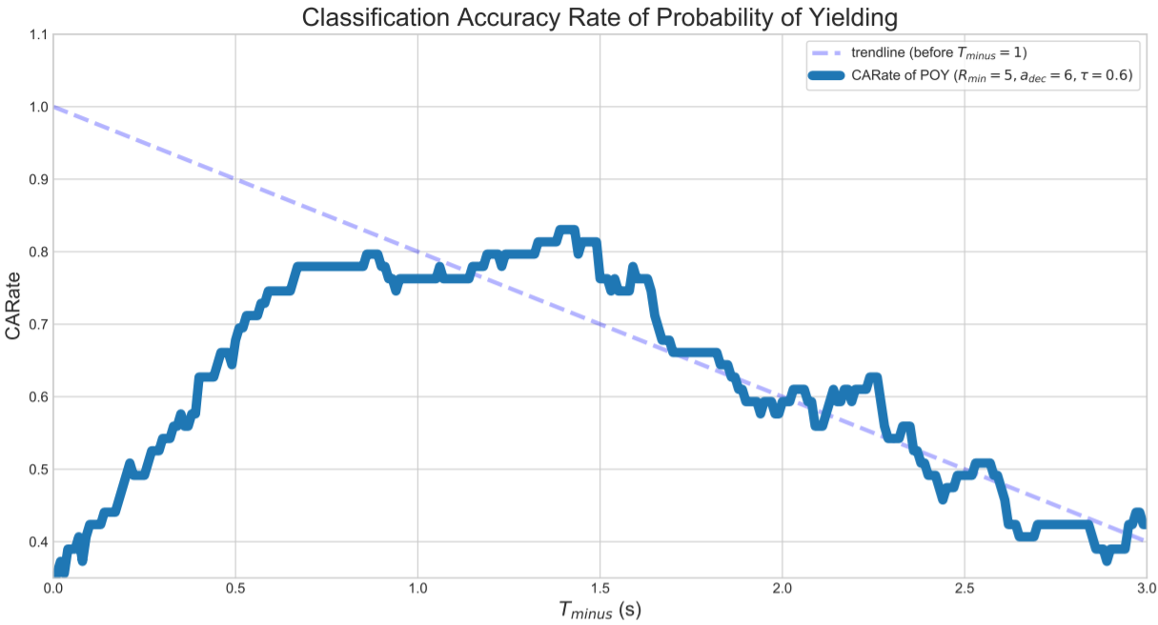
Validation : Driver behaviors model
The time lines are reversed since the duration of trials are different.
Prediction accuracy is 0.82 when is 1.5 sec.
The drop from 0.0 to 1.3 is due to the over-aggressive behaviors at the simulated crossroad.
Classification accuracy is 0.82
Over-aggressive behaviors

Slide 18
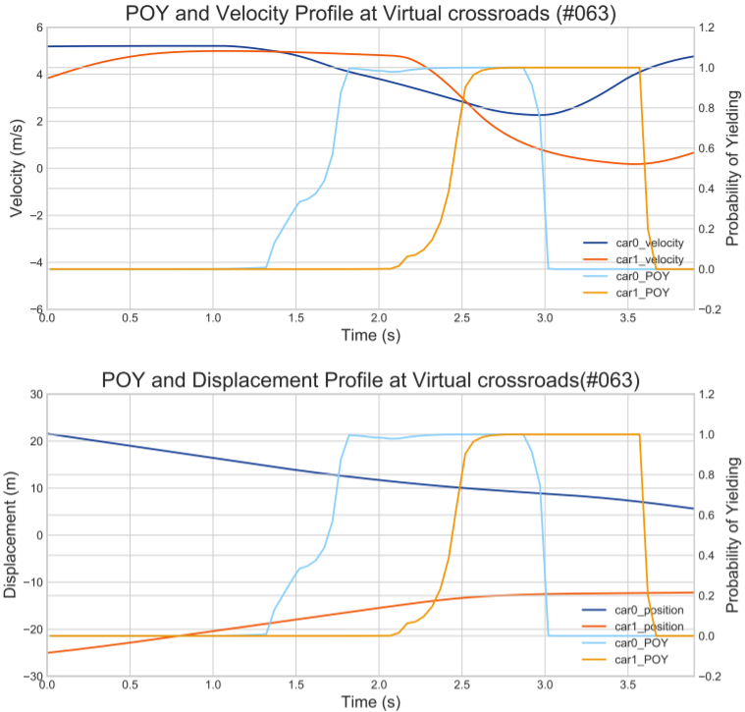
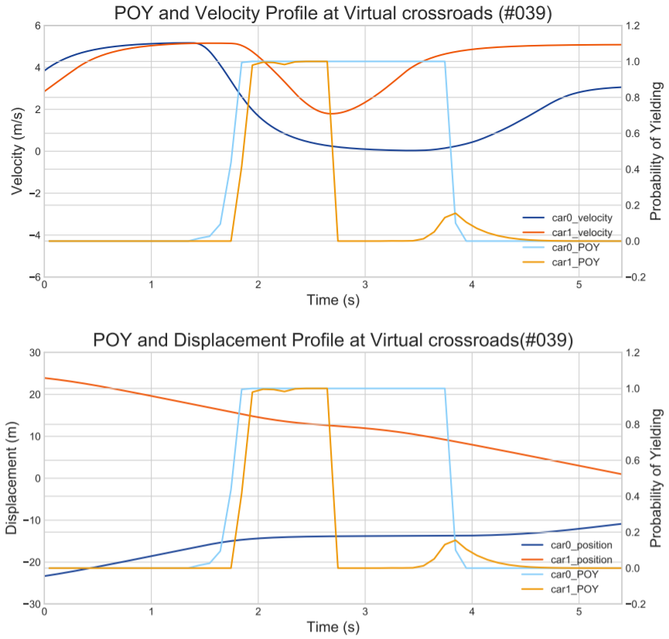
Validation : Driver behaviors model
Wrong Prediction
(blue line)
Wrong Prediction
(Orange line)
Correct Prediction
(Orange line)
Correct Prediction
(Blue line)

Slide 19
Summary
A probabilistic driver behaviors model is proposed.
The prediction for the yielding behavior is reasonable.
The validation experiments are conducted in virtual crossroad.
The Classification Accuracy Rate is 0.82 at 1.5 sec before the interactions end.

Slide 20
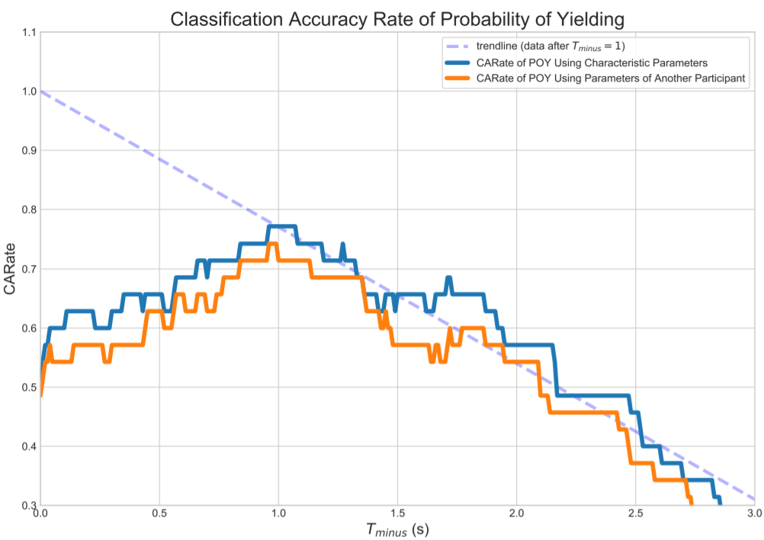
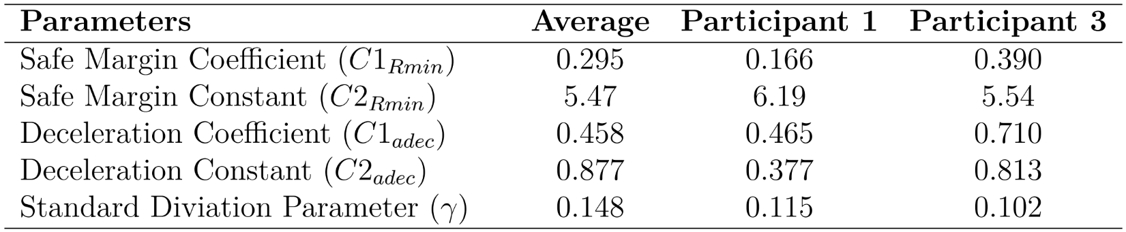
Application : Parameter identification
Characteristic parameters in the formulation of TFA distribution.
We can have better prediction from
more accurate characteristic parameters
Can we obtain the
characteristic parameters
by optimizing the CARate curve ?

Slide 21
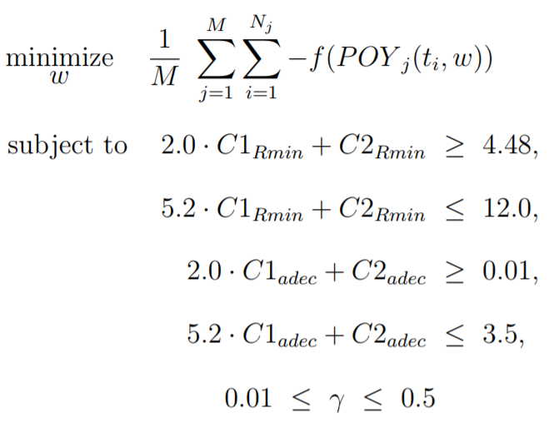
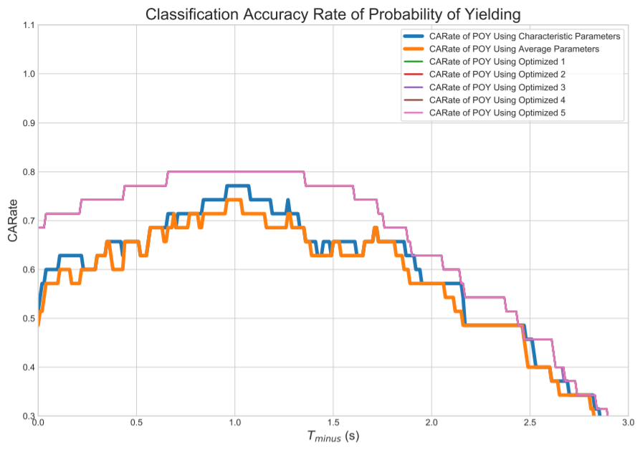
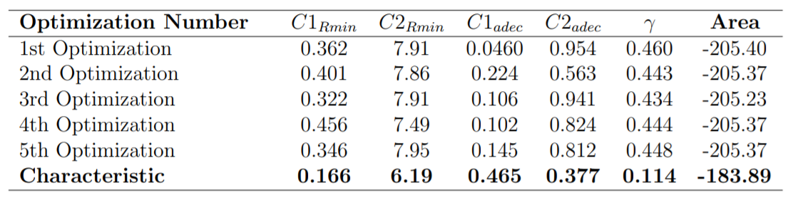
Application : Parameter identification
Results here is unreasonable.
Modifications for objective function
could be designed.
Optimization : Simulated Annealing
Preliminary results show that
better CARate curve is found
but the parameters are far off.

Slide 22
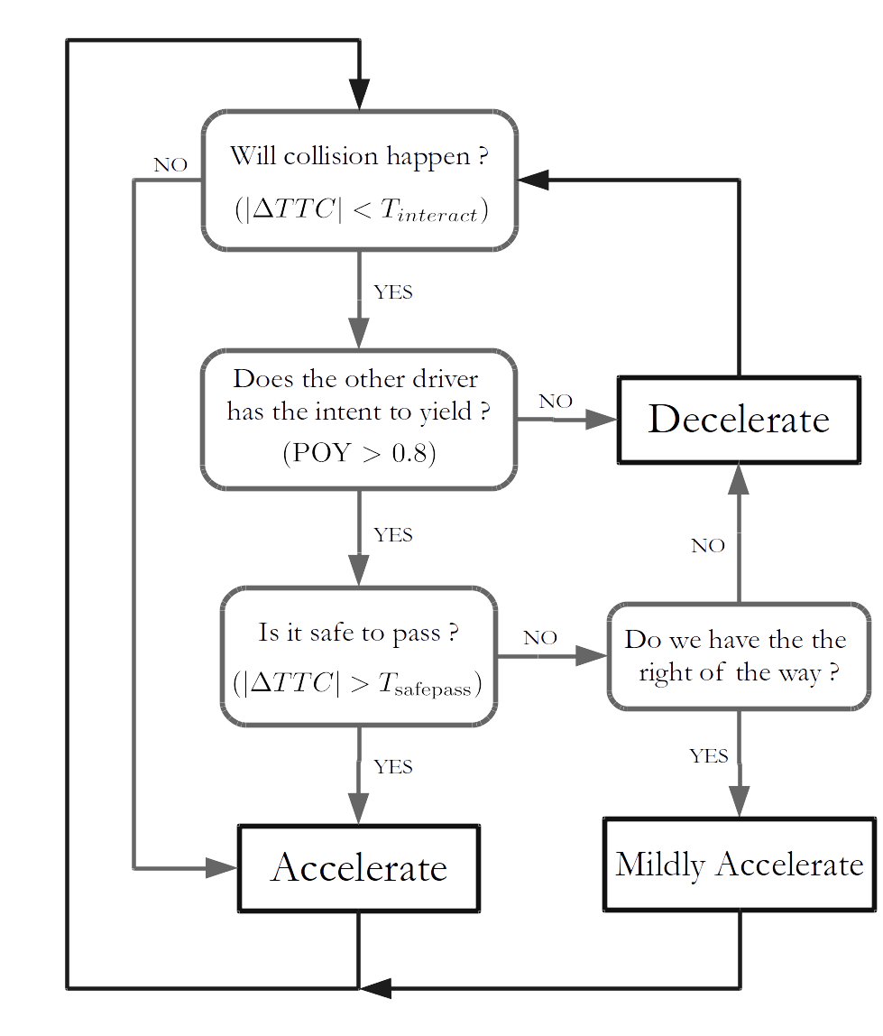
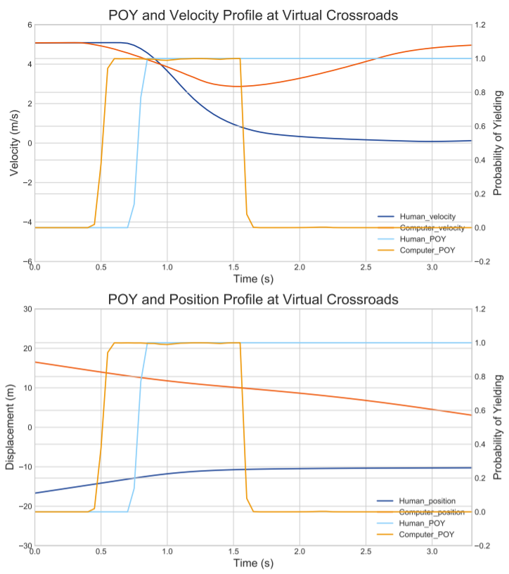
Application : Procedure for handling complex interaction
A procedure is developed for autonomous vehicle to handle complex interaction. ( e.g. when both traffic participants are yielding )
After the proposed model was applied, the autonomous vehicle understand that the gesture of yielding, so it passed.
The autonomous vehicle waited until it
was safe to pass before it finally passed.

Slide 23
Contributions
The driver decision making process at unsignalized crossroads is identified
A probabilistic driver behaviors model is proposed and the validation result suggests the accuracy rate at 1.5 secs before interactions end is 0.82.
Possible application are explored and preliminary attempts show promising results.
This paper has been accepted by 2019 ASME IDETC/CIE .

Slide 24
Future Works
Multi-agents behaviors prediction could be a great extension.
The control method in the simulated environment can be more realistic to prevent over aggressive actions.
More data from urban crossroads should be collected to verify the applicability of the proposed model.
Modifications for the parameter identification.
Construct a hardware platform and apply the proposed model to the autonomous devices.

Slide 25
Thank You !

